Slide 1


CSE440: AI
ADVENTURE QUEST GAME
GROUP-09
BY
Md Shehan Miah-1911048642
Ahmed Sadman-2014094042
Tawhid Islam-2021499042
Arin Paul Niloy-2211902042

Slide 2


Problem Statement & Overview
Objective: To create an interactive adventure game where the player's decisions influence the outcome, using factor graphs for dynamic decision-making.
Challenge: Building a game that combines storytelling with probabilistic decision-making and a user-friendly graphical interface.

Slide 3
Game Concept & Features
Core Concept: Players embark on an adventure in Dhaka, exploring landmarks, making decisions, and uncovering treasure.
Features:
Factor Graphs for dynamic decision-making (Health, Reputation, Combat Ability).
Random Events (e.g., fighting bandits, finding items).
Multiple Locations: Lalbagh Fort, Sadarghat, National Museum, Sundarbans, Ahsan Manzil.
Interactive GUI: Built with Tkinter for player interaction.

Slide 4
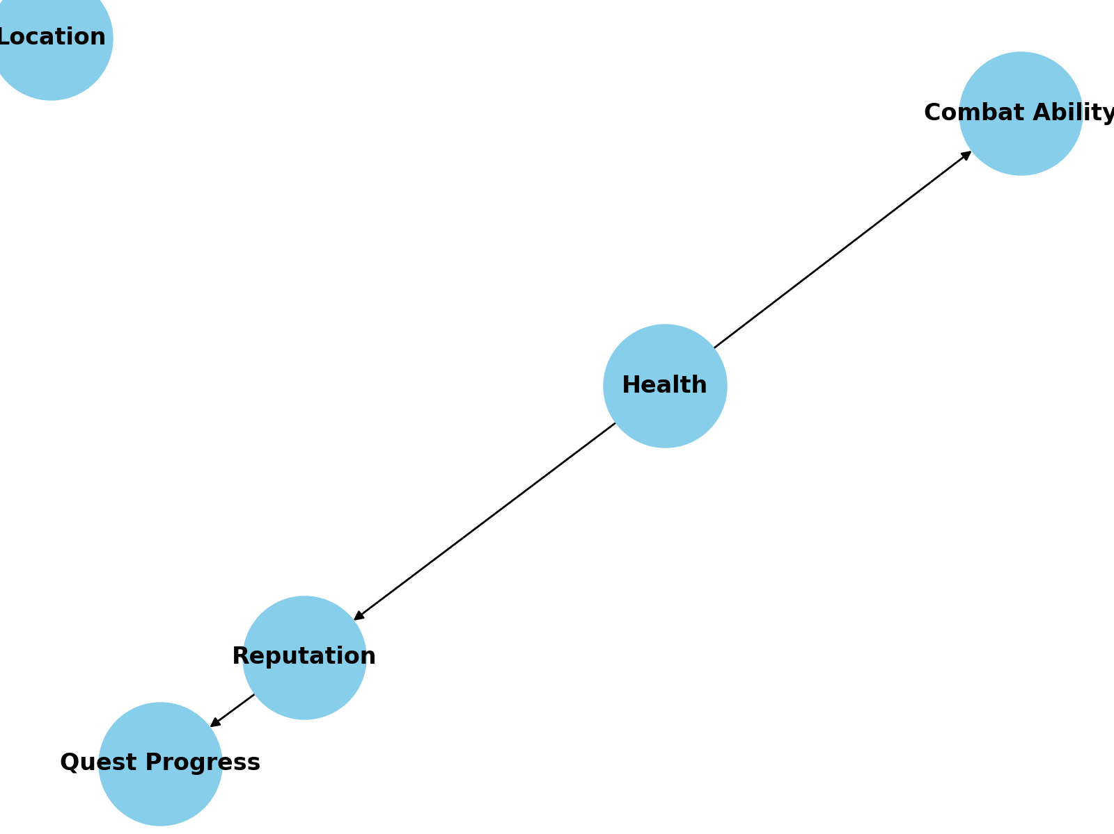
Factor Graph Integration
Features:
Factor Graph: Models the probabilistic relationships between health, reputation, and combat ability.
Dependencies: Health → Reputation, Reputation → Quest Progress, Health → Combat Ability.
How it Works: Probabilities for health, reputation, etc., are dynamically updated based on the player’s actions.

Slide 5
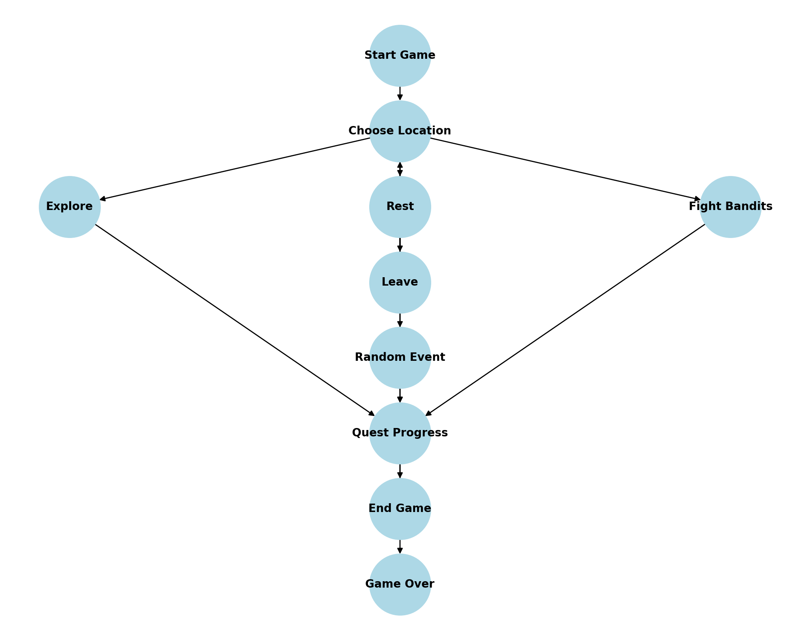
Game Flow & User Interaction
Features:
The player chooses a starting location (e.g., Lalbagh Fort).
They can choose between multiple actions (e.g., explore, fight, random events).
Decisions influence health, reputation, and quest progress.
The game ends when the quest is completed or the player’s health reaches 0.

Slide 6
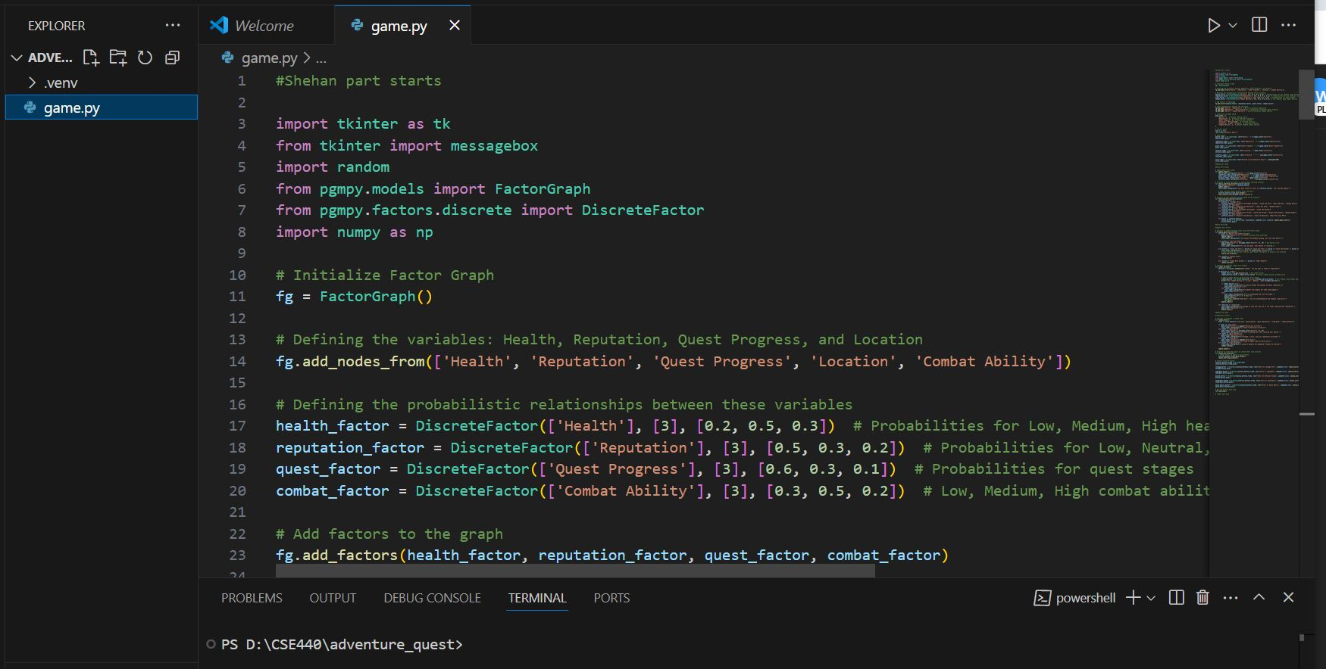
Technical Implementation
Features:
Factor Graph: Managed using pgmpy.
Tkinter GUI: Used for displaying the game state (labels for health, reputation) and interacting with the player via buttons.
Probabilistic Logic: Decisions such as combat outcome, random events, and quest progress are determined using the factor graph’s probabilities.

Slide 7
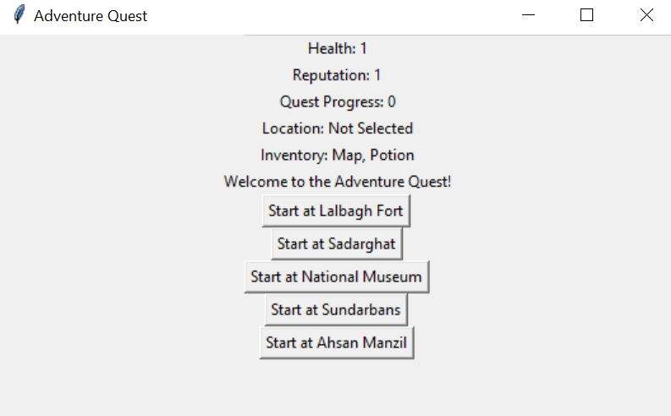
User Interaction & Gameplay
Features:
Location Choices: he player chooses their starting location (e.g., Lalbagh Fort).
Actions: Locations offer sub-actions (explore, fight, rest, random event).
Story Prompts: Narrative text is displayed as the game progresses (e.g., after exploring or fighting).

Slide 8


Results & Outcomes
Results
Quest Completion: The game ends when the player completes the quest or when health reaches zero.
Replayability: Each playthrough offers different outcomes due to random events and dynamic decision-making.
Challenges Overcome: Ensuring the probabilistic logic was properly integrated, maintaining game balance, and keeping the game engaging.

Slide 9

Future Works
Expanded Locations
More Interactive NPCs
Graphical Enhancements

Slide 10
Conclusion
Summary: "Adventure Quest" successfully combines probabilistic decision-making and interactive gameplay with Tkinter for a simple yet engaging game experience.
Reflection: This project serves as a base for more complex adventure games with AI-driven decision-making and graphical improvements.
Closing Thoughts: The project demonstrates the use of factor graphs in interactive storytelling and can be expanded further with multiplayer and advanced graphics.

